Slide 1

Preparation for Lab 2
Week 4
Semester 1, 2025
Dr. Farshid Keivanian

Slide 2
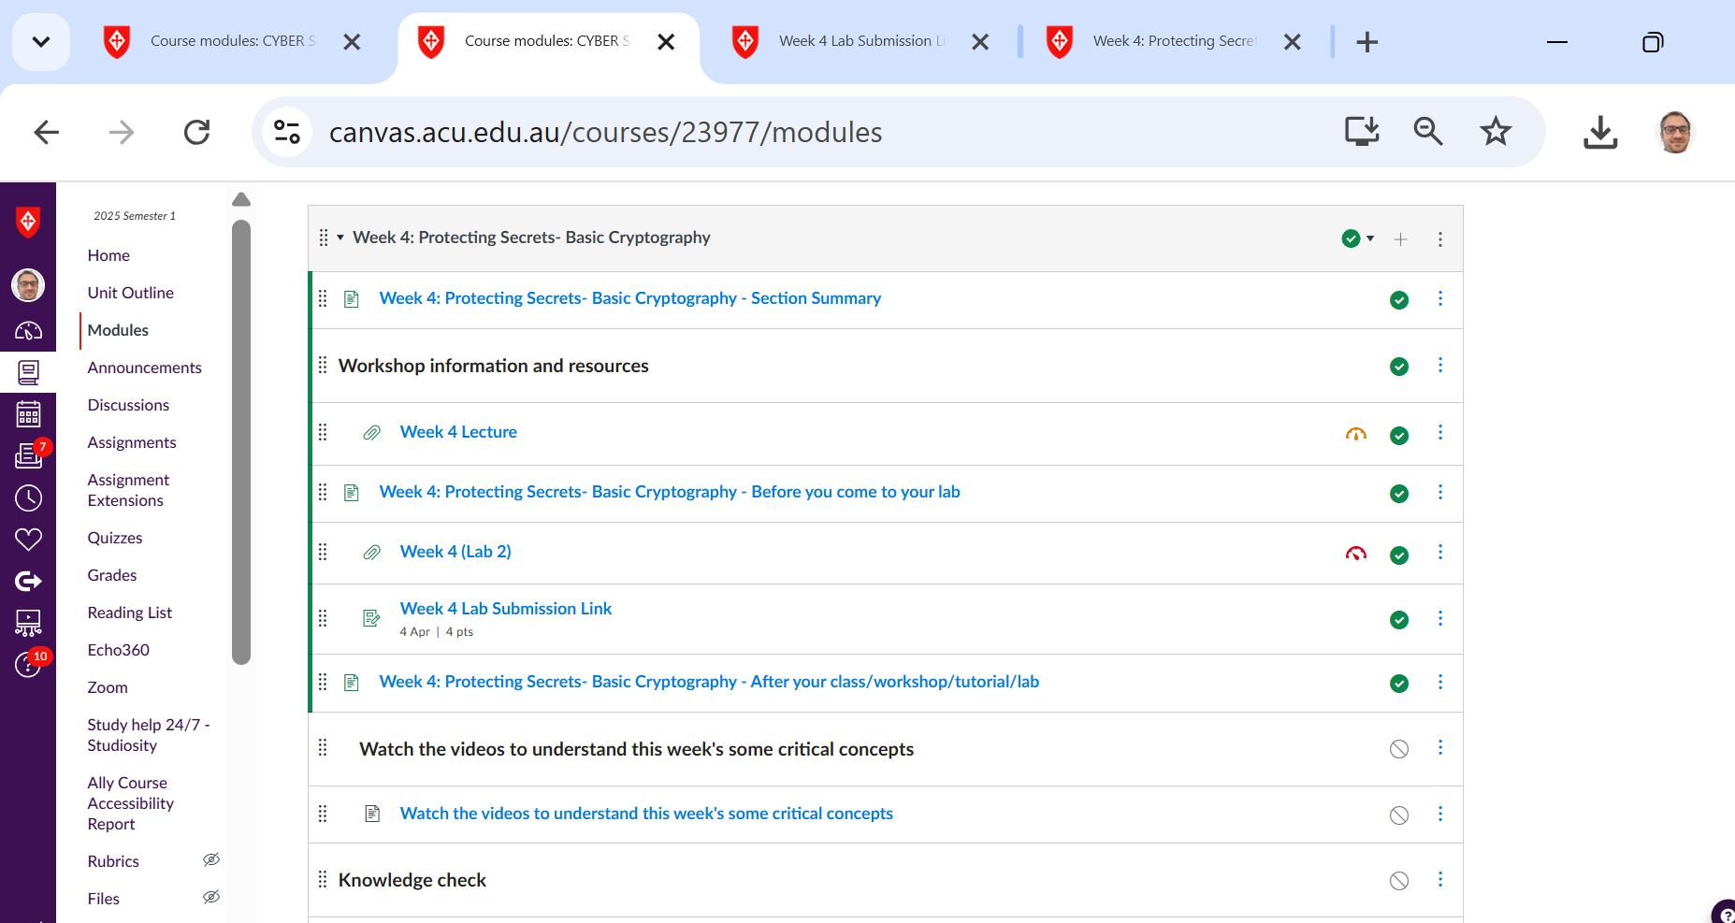
Preparation for Lab 2 (Week 4) – VirtualBox and Kali Linux
Navigate Canvas >> Week 4 >> Lab 2 (submit a word document with screenshot)

Slide 3
Preparation for Lab 2 (Week 4) – VirtualBox and Kali Linux
Introduction
Today, we will work with VirtualBox and Kali Linux to set up a virtual machine (VM) for penetration testing and security analysis. This lab will guide you step-by-step through installing VirtualBox and setting up Kali Linux.

Slide 4
Preparation for Lab 2 (Week 4) – VirtualBox and Kali Linux
What is VirtualBox?
VirtualBox is an open-source tool developed by Oracle that allows users to create and run multiple operating systems on a single computer. It supports Windows, macOS, and Linux machines.
Why Use VirtualBox?
Runs multiple OS environments on one device
Isolates software for testing and development
Useful for penetration testing and ethical hacking

Slide 5
Preparation for Lab 2 (Week 4) – VirtualBox and Kali Linux
What Are We Doing in This Lab?
This lab is about setting up a virtual environment where we can run Kali Linux inside Oracle VirtualBox on our Windows computer.
This means:
We don’t need to install Kali Linux directly on our main computer.
Instead, we create a virtual machine (VM) that runs Kali Linux inside Windows, like an app.
This allows us to experiment with cybersecurity tools in Kali Linux without affecting our main operating system.

Slide 6
Preparation for Lab 2 (Week 4) – VirtualBox and Kali Linux
What is Oracle VirtualBox Manager?
Oracle VirtualBox is a virtualization software.
It allows us to run multiple operating systems (like Kali Linux) inside our computer.
Think of it like a computer inside our computer.
Instead of buying a separate computer for Kali Linux, we use VirtualBox to create a virtual computer.

Slide 7
Preparation for Lab 2 (Week 4) – VirtualBox and Kali Linux
Main Purpose of VirtualBox in this Lab:
To install and run Kali Linux in a safe, isolated environment.

Slide 8
Preparation for Lab 2 (Week 4) – VirtualBox and Kali Linux
What is Kali Linux?
Kali Linux is a special operating system designed for penetration testing, cybersecurity, and ethical hacking.
It comes with many security tools used by cybersecurity professionals.
Kali Linux is based on Linux, meaning it looks and works differently from Windows.

Slide 9
Preparation for Lab 2 (Week 4) – VirtualBox and Kali Linux
Main Purpose of Kali Linux in this Lab:
To practice cybersecurity skills in a controlled environment.
To explore tools that help in ethical hacking, network security, and system security.

Slide 10
Preparation for Lab 2 (Week 4) – VirtualBox and Kali Linux
How Do VirtualBox and Kali Linux Work Together?
VirtualBox is the software that runs Kali Linux as a virtual machine. Here’s the relationship step-by-step:
We install VirtualBox on Windows.
This gives us the ability to create virtual computers.

Slide 11
Preparation for Lab 2 (Week 4) – VirtualBox and Kali Linux
We download and install Kali Linux inside VirtualBox.
Instead of installing it directly on our computer, we install it inside a virtual machine.
Now, we can use Kali Linux within VirtualBox.
We can open VirtualBox → Start Kali Linux → Use it without affecting our Windows system.

Slide 12
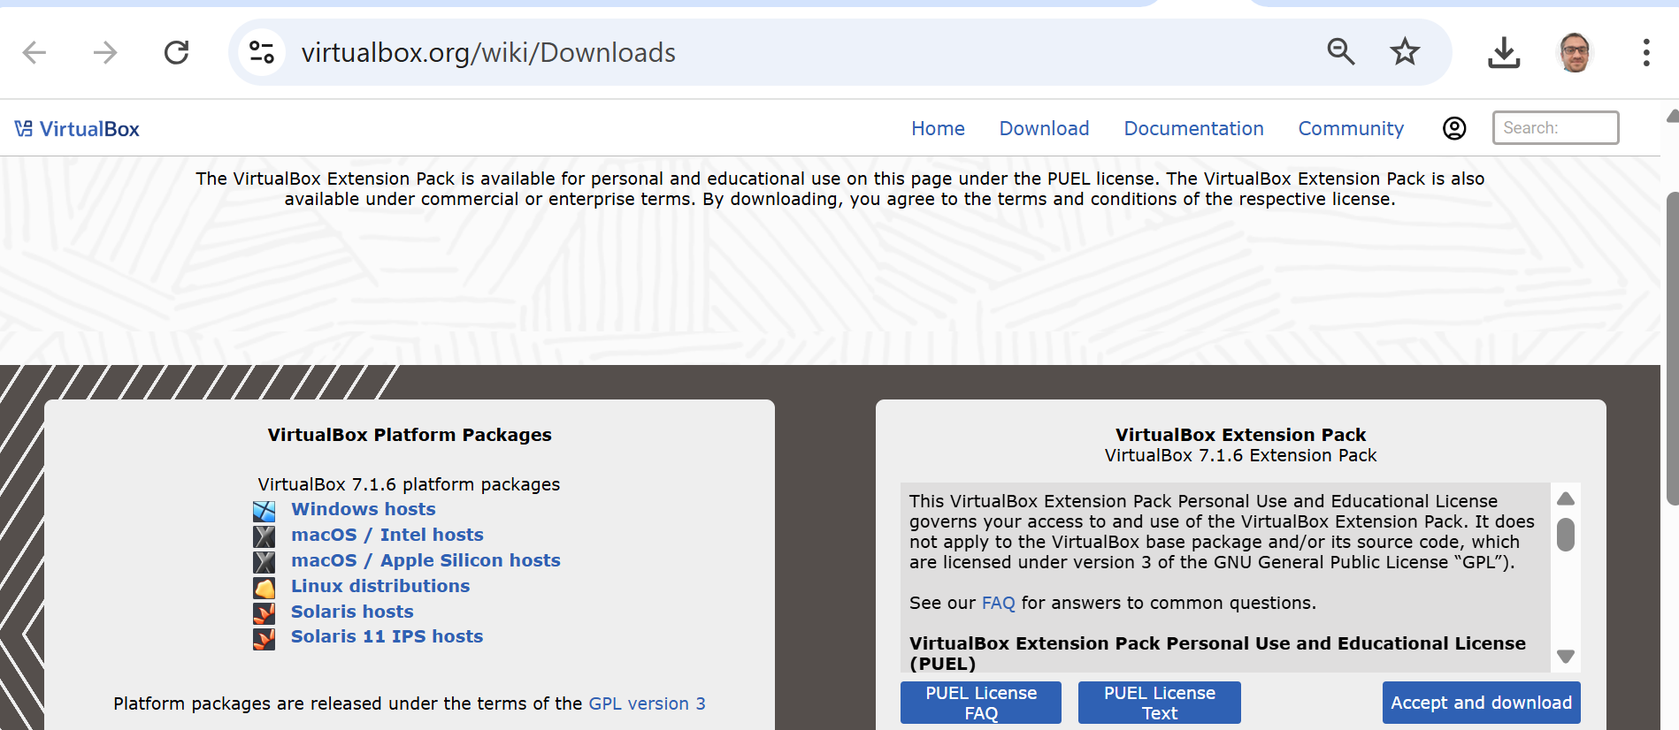
Preparation for Lab 2 (Week 4) – VirtualBox and Kali Linux
Installing VirtualBox
Follow these steps to install VirtualBox:
Download VirtualBox from the official website: https://www.virtualbox.org/wiki/Downloads
We should choose the "Windows hosts" option if we are installing VirtualBox on a Windows machine. If we are using macOS, we choose either "macOS / Intel hosts" or "macOS / Apple Silicon hosts", depending on our system.
For Linux users, we select "Linux distributions".

Slide 13
Running on MacOS
Kali Linux can absolutely run on macOS —you can use it with VirtualBox for macOS or UTM (for Apple Silicon chips).
There are two recommended solutions:

Slide 14
Running on MacOS
Option 1: Use VirtualBox (Intel Mac) If your Mac has an Intel processor, you can continue using VirtualBox:
Download the Kali Linux ISO (Installer) version from the official Kali Downloads page. (suitable for Intel-based Macs running VirtualBox)
Set it up as a new VM in VirtualBox.
Follow the same steps provided for Windows users in the Week 8 lab guide.
Make sure to choose the "Installer" ISO for your architecture (amd64 for Intel Macs).
X Do not use the Live or NetInstaller versions for lab-based VirtualBox installation.

Slide 15
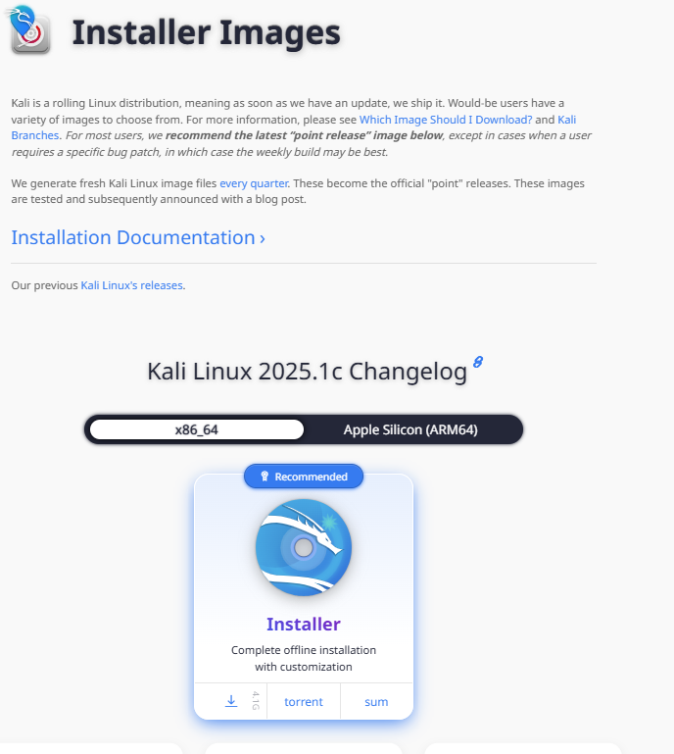
Running on MacOS
You should download the Installer Image for x86_64 architecture, which is compatible with VirtualBox on Intel Macs.
Link to download (Installer Image): https://www.kali.org/get-kali/#kali-installer-images

Slide 16
Running on MacOS
Choose x86_64 (not Apple Silicon), then download the Installer ISO file.
This version allows full installation with customization via VirtualBox.

Slide 17
Running on MacOS
If you are using an Apple Silicon (M1, M2, M3) Mac:
VirtualBox may not work properly. In this case, option 2 is recommend:
Download UTM from https://mac.getutm.app/
Then use the ARM64 image from this page: https://www.kali.org/get-kali/#kali-arm

Slide 18
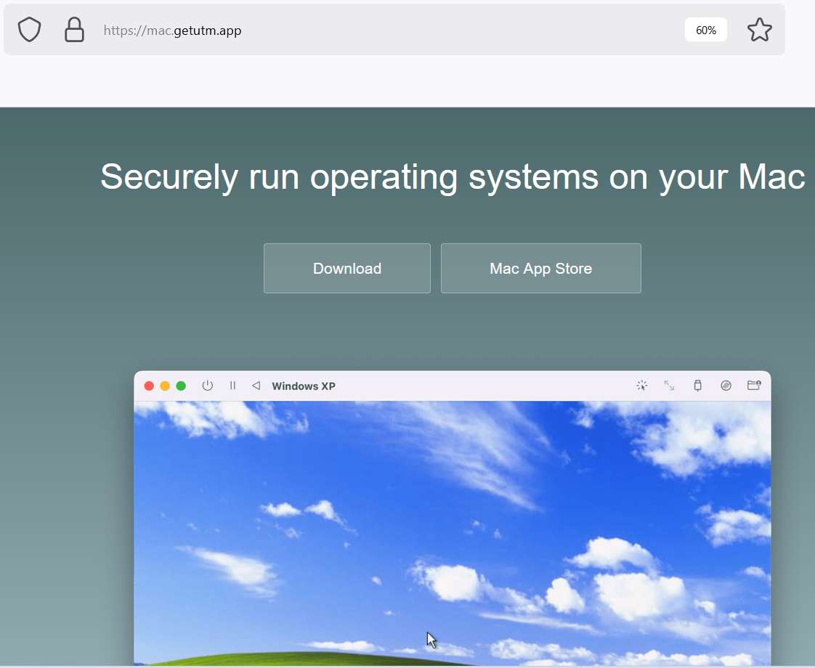
Running on MacOS
Option 2: Use UTM (Apple Silicon/M1/M2/M3 chips) If you are using an M1/M2/M3 Mac, VirtualBox may not work as expected. In that case:
Download and install UTM from https://mac.getutm.app/
Use a pre-built Kali ARM image from Kali ARM images.
Import it into UTM and start your Kali environment.

Slide 19
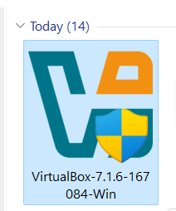
Preparation for Lab 2 (Week 4) – VirtualBox and Kali Linux
2. Once downloaded, locate the installation file on your computer and double-click to start the installation (Run as Administrator)

Slide 20
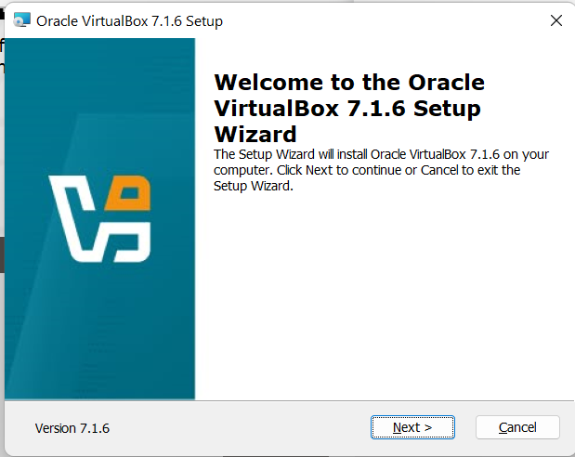
Preparation for Lab 2 (Week 4) – VirtualBox and Kali Linux
3. Click on Next

Slide 21
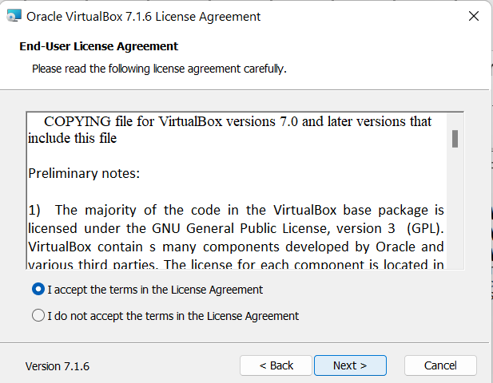
Preparation for Lab 2 (Week 4) – VirtualBox and Kali Linux
4. Accept & Click on Next

Slide 22
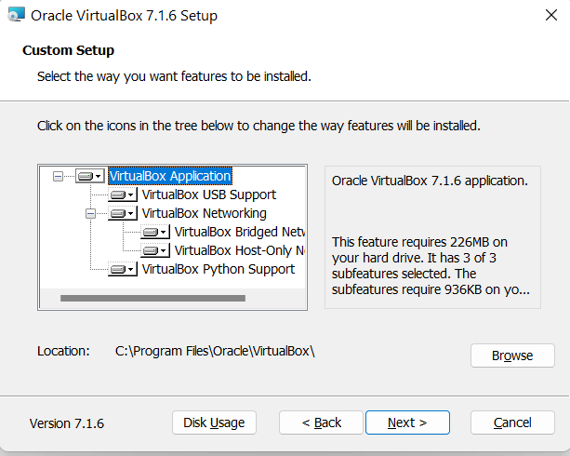
Preparation for Lab 2 (Week 4) – VirtualBox and Kali Linux
VirtualBox Application (Mandatory for installation)
VirtualBox USB Support (Recommended for USB device compatibility)
VirtualBox Networking (Includes Bridged Networking, Host-Only Networking, and other network features—recommended to keep)

Slide 23
Preparation for Lab 2 (Week 4) – VirtualBox and Kali Linux
VirtualBox Python Support (Optional, but useful if you plan to run automation scripts)
5. Keep the default options selected & proceed with the installation

Slide 24
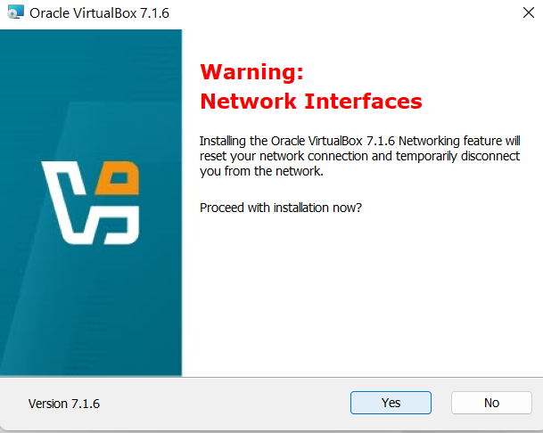
Preparation for Lab 2 (Week 4) – VirtualBox and Kali Linux
Click on Next & Yes

Slide 25
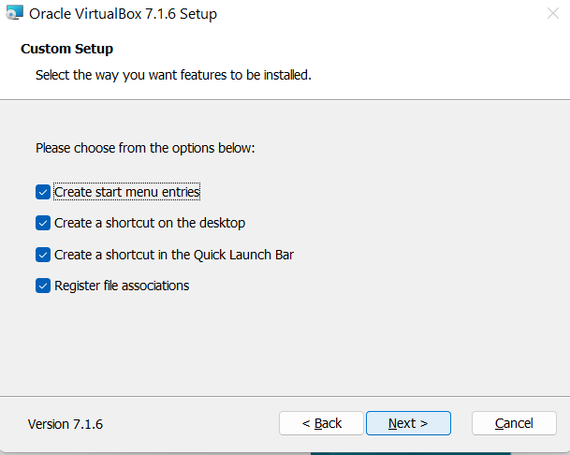
Preparation for Lab 2 (Week 4) – VirtualBox and Kali Linux
Next

Slide 26
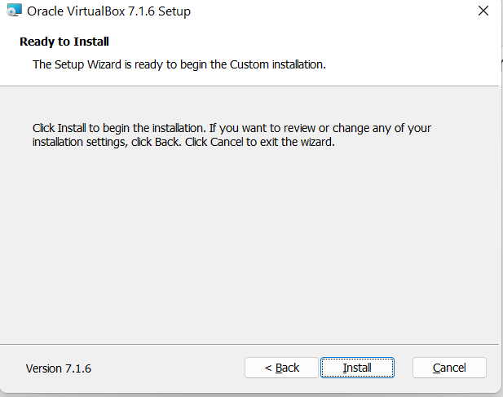
Preparation for Lab 2 (Week 4) – VirtualBox and Kali Linux
Install

Slide 27
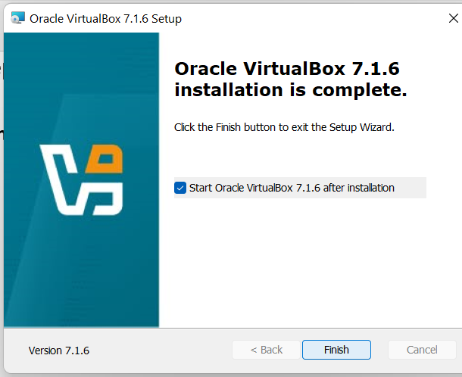
Preparation for Lab 2 (Week 4) – VirtualBox and Kali Linux
Click Finish to exit the setup wizard

Slide 28
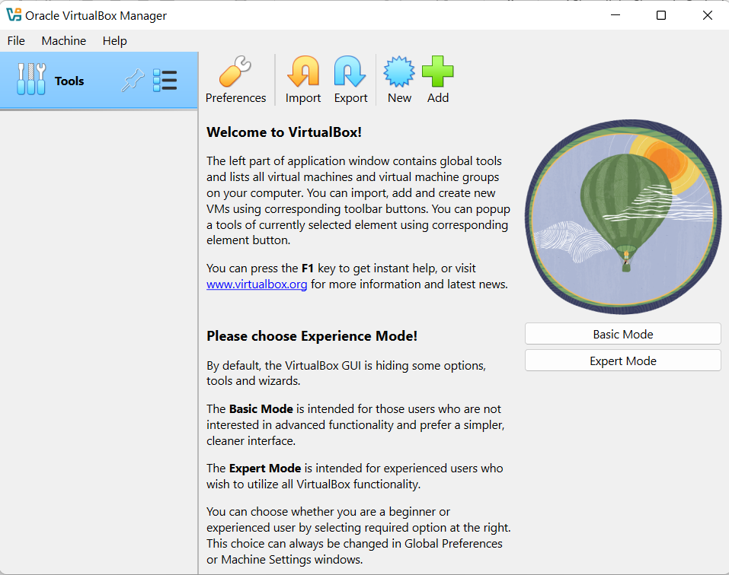
Preparation for Lab 2 (Week 4) – VirtualBox and Kali Linux
Now Virtual Box is ready to use
If you are a beginner, select "Basic Mode" (Recommended).
It provides a simpler interface with essential options for creating and managing virtual machines.

Slide 29
Preparation for Lab 2 (Week 4) – VirtualBox and Kali Linux
If you are comfortable with advanced settings, select "Expert Mode".
This mode gives you more flexibility when setting up virtual machines, such as manually configuring storage, memory, and network settings.

Slide 30
Preparation for Lab 2 (Week 4) – VirtualBox and Kali Linux
Currently, we select Basic Mode. We can always switch to Expert Mode later from the preferences if needed.

Slide 31
Preparation for Lab 2 (Week 4) – VirtualBox and Kali Linux
What is Kali Linux?
Kali Linux is a Linux distribution designed for penetration testing, security auditing, and ethical hacking. It comes pre-installed with a wide range of cybersecurity tools.

Slide 32
Preparation for Lab 2 (Week 4) – VirtualBox and Kali Linux
Why Use Kali Linux?
Includes essential security and penetration testing tools
Helps in cybersecurity training and research
Open-source and regularly updated

Slide 33
Preparation for Lab 2 (Week 4) – VirtualBox and Kali Linux
Installing Kali Linux on VirtualBox
Follow these steps to install Kali Linux on your VirtualBox:
Download Kali Linux from the official website: https://www.kali.org/get-kali/#kali-platforms

Slide 34
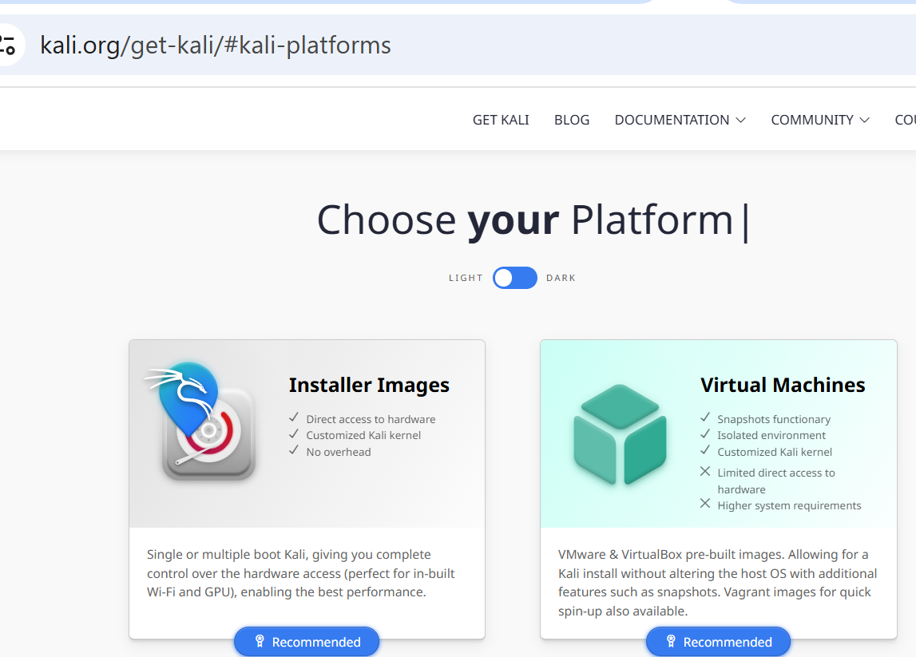
Preparation for Lab 2 (Week 4) – VirtualBox and Kali Linux
We plan to download the 64-bit ISO file

Slide 35
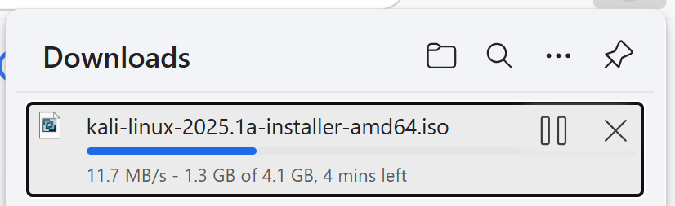
Preparation for Lab 2 (Week 4) – VirtualBox and Kali Linux
Wait 5-6 minutes until the file is completed

Slide 36
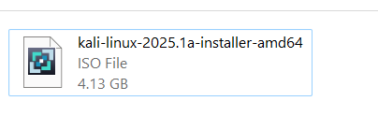
Preparation for Lab 2 (Week 4) – VirtualBox and Kali Linux
Once downloaded, we can install Kali Linux on our VirtualBox

Slide 37
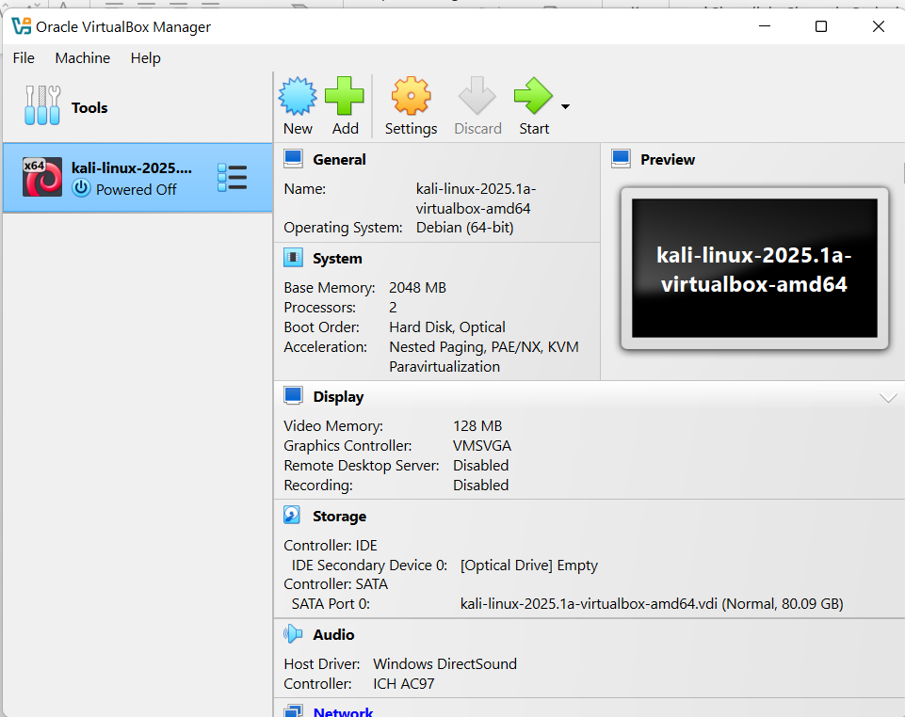
Preparation for Lab 2 (Week 4) – VirtualBox and Kali Linux
Click on New
Write a name for the virtual machine e.g., kali
Type: Linux
Version: Oracle Linux

Slide 38
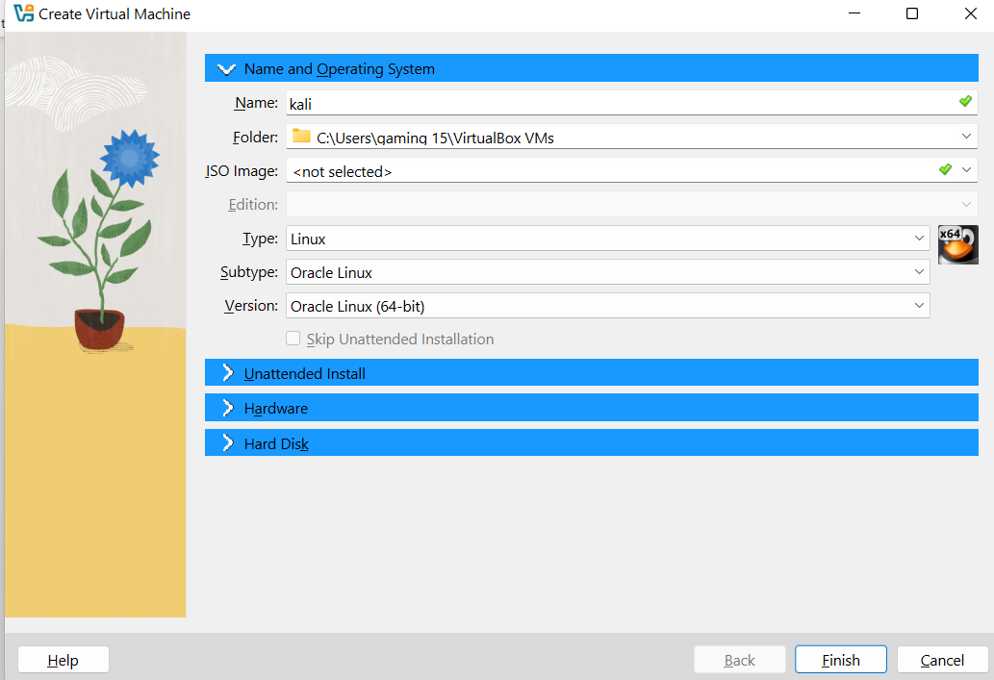
Preparation for Lab 2 (Week 4) – VirtualBox and Kali Linux
Click on New
Write a name for the virtual machine e.g., kali
Type: Linux
Version: Oracle Linux

Slide 39
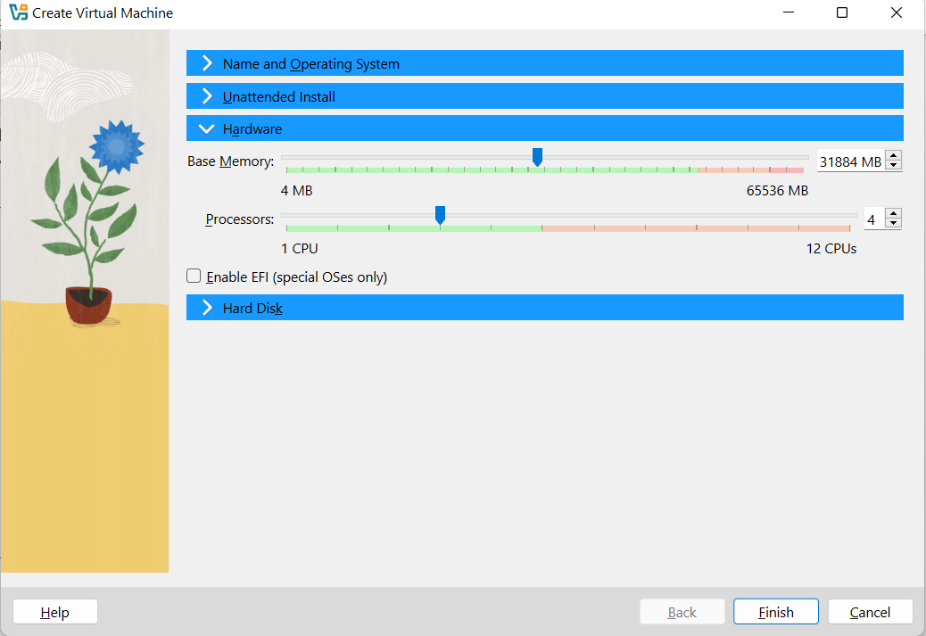
Preparation for Lab 2 (Week 4) – VirtualBox and Kali Linux
Base Memory Size: Up to red (end of green level) ~ 3G
Processor CPU 4

Slide 40
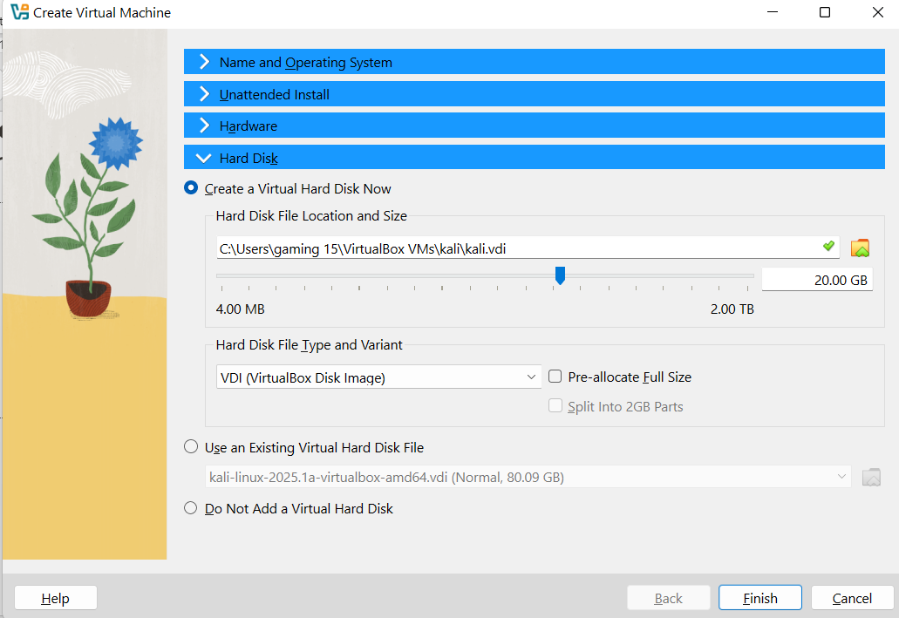
Preparation for Lab 2 (Week 4) – VirtualBox and Kali Linux
Hard Disk File Type: VDI (Virtual Disk Image)
Create
Hard Disk File Type: VDI (Virtual Disk Image)
Finish

Slide 41
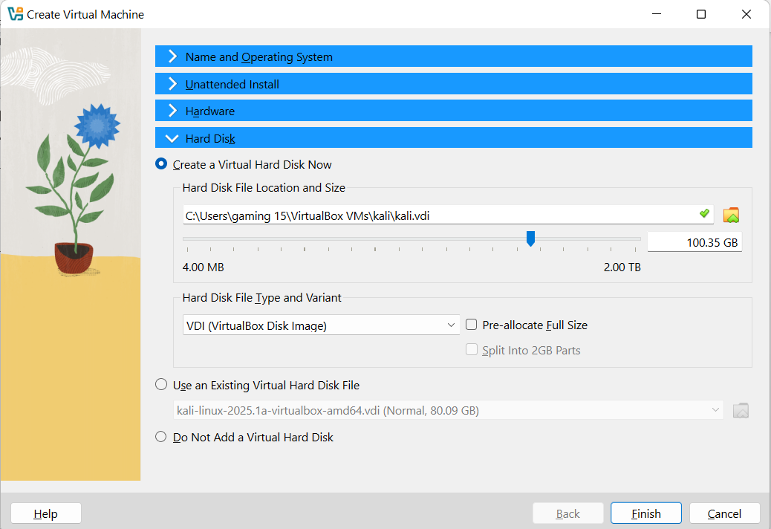
Preparation for Lab 2 (Week 4) – VirtualBox and Kali Linux
File Location and Size: Move Size to around 100 GB
Finish → It will create a virtual machine on Virtual Box Manager

Slide 42
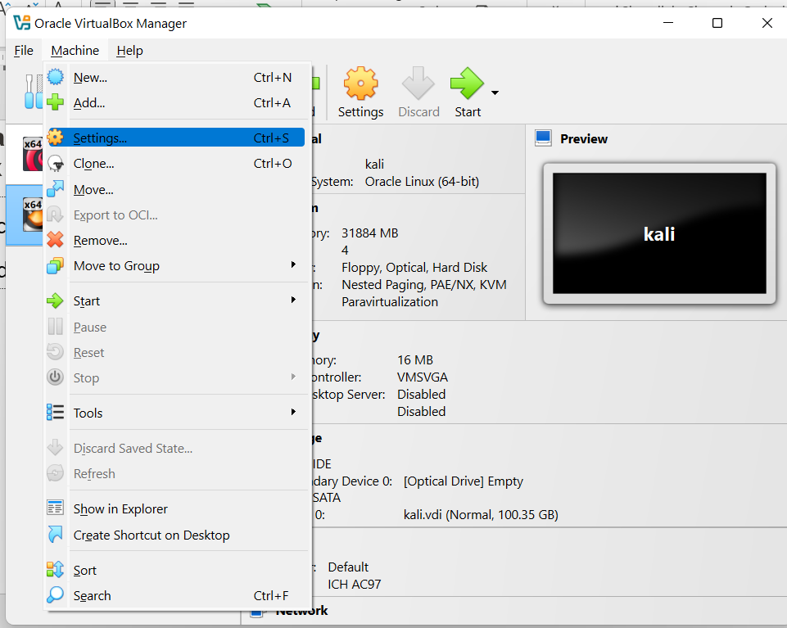
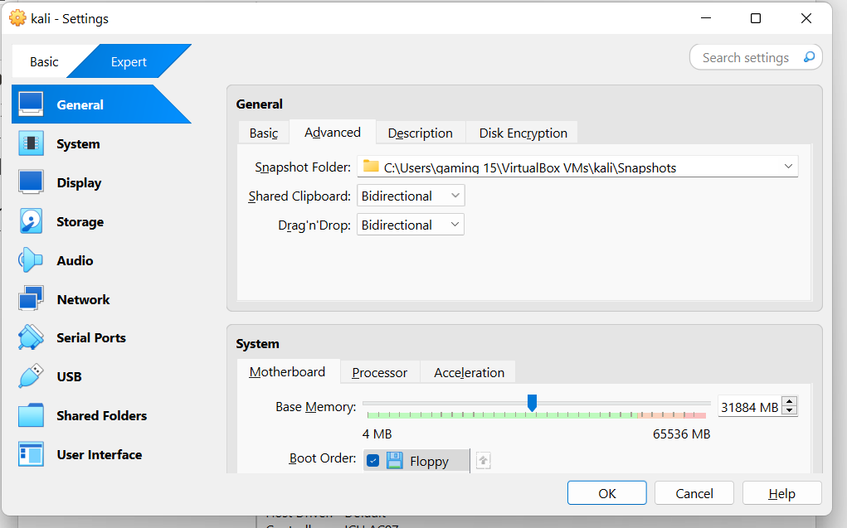
Preparation for Lab 2 (Week 4) – VirtualBox and Kali Linux
Click on Settings >> General >> Advanced >> Shared Clipboard (Bidirectional) and Drag & Drop (Bidirectional)

Slide 43
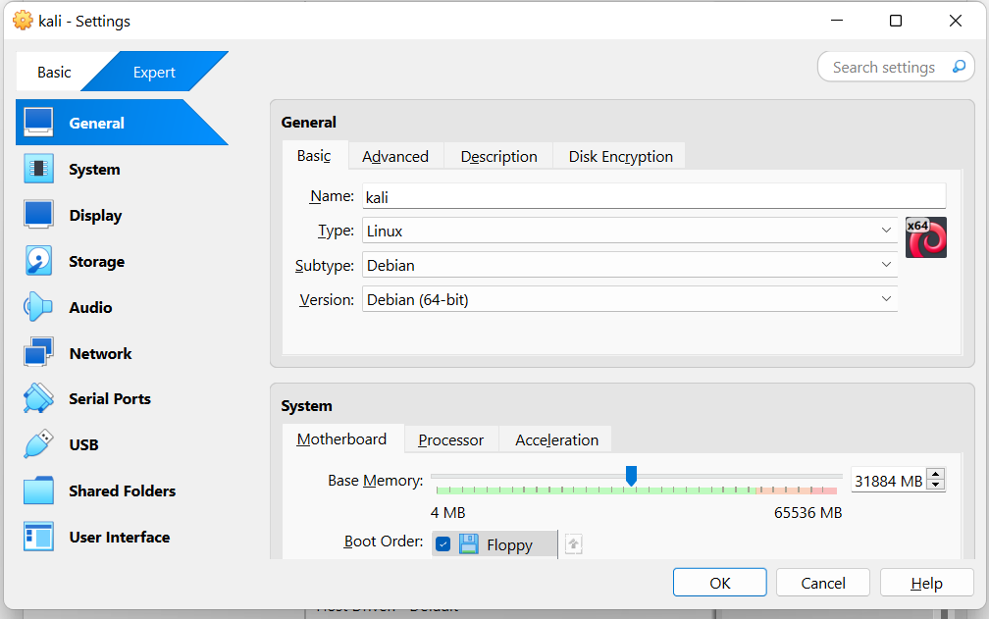
Preparation for Lab 2 (Week 4) – VirtualBox and Kali Linux
Kali General Settings: Type = Linux, Subtype = Debian
Since Kali Linux is based on Debian, using Debian (64-bit) ensures proper compatibility with the virtual machine settings.

Slide 44
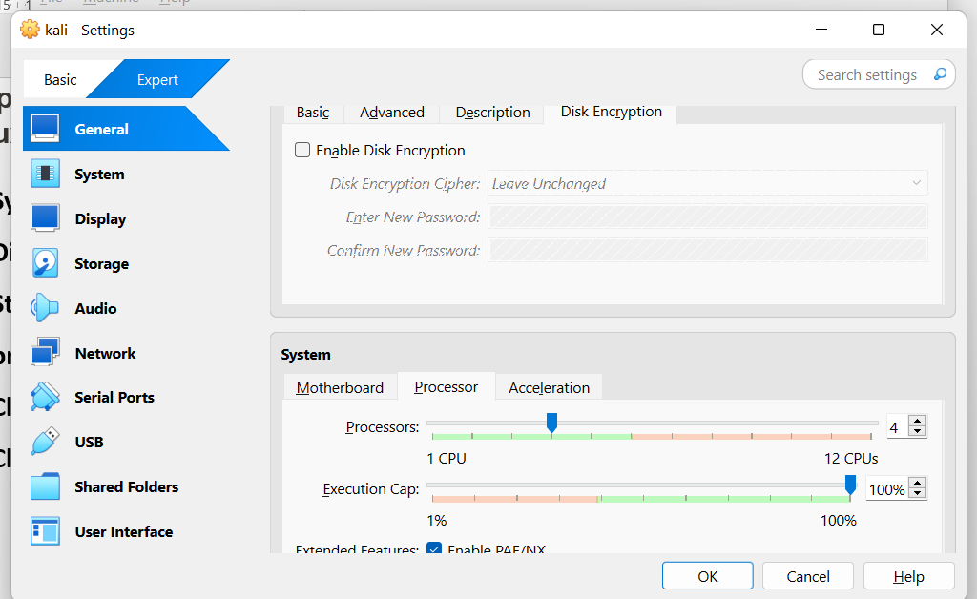
Preparation for Lab 2 (Week 4) – VirtualBox and Kali Linux
System → Processor → Assign 4 CPU to Virtual Machine

Slide 45
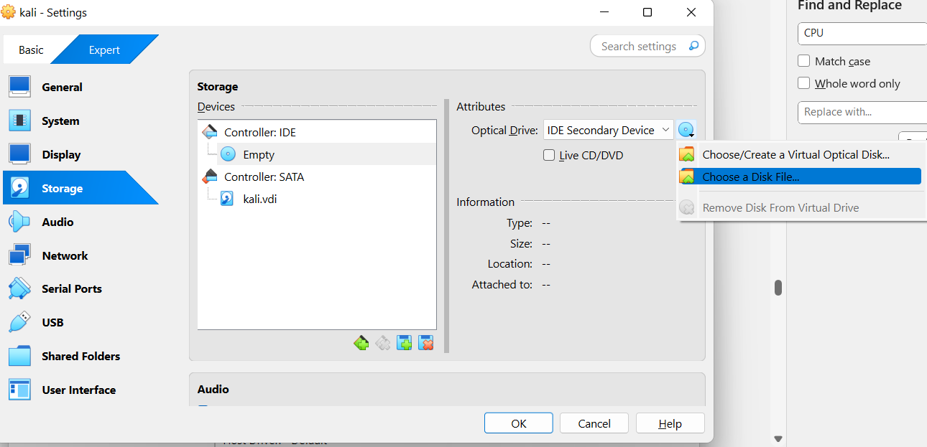
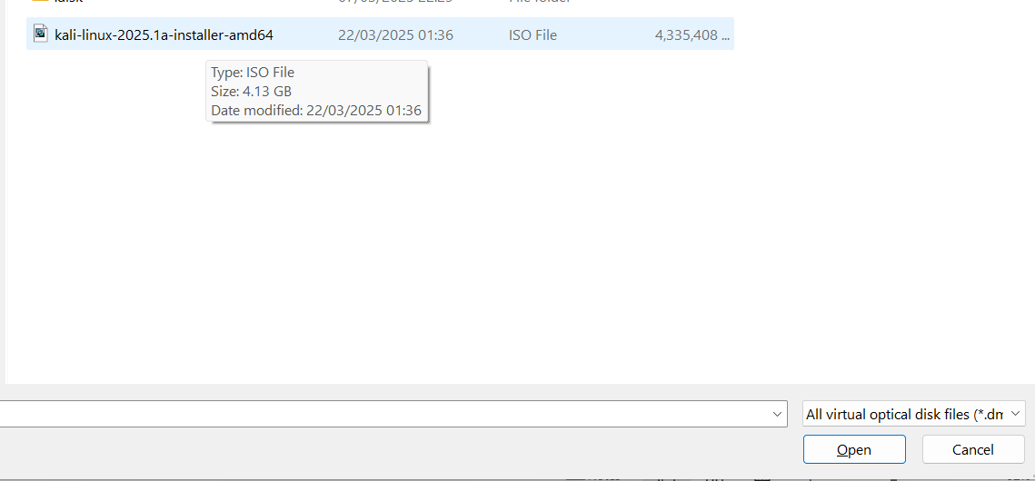
Preparation for Lab 2 (Week 4) – VirtualBox and Kali Linux
Display → Default
Storage → Controller – IDE → Empty → Optical Drive → Choose a Disk file → browse to the path you downloaded iso file (open)
Click Start

Slide 46
Preparation for Lab 2 (Week 4) – VirtualBox and Kali Linux
Select Language (English)
Select Location
Configure Keyboard Layout
If it asks for host name by default is it kali
Domain name → leave it blank
Full name of new user → e.g., kali or codebind

Slide 47
Preparation for Lab 2 (Week 4) – VirtualBox and Kali Linux
Set a Password when you login to Kali Linus (remember when you log in)
Choose a clock → Central region
Partition Disks → Guided use entire disk
Continue
Partition Disks → All files in one partition
Finish Partitioning and write changes to disk
Write the changes to disk? Yes

Slide 48
Preparation for Lab 2 (Week 4) – VirtualBox and Kali Linux
Configure the Package Manager → Blank & Continue
Software Selection → Be default & Continue
Installation step failed (Click on Continue)
Install the GRUB boot loader on a hard disk? Yes
Enter device manually → /dev/sda ..
Wait for Kali Linus to restart

Slide 49
Preparation for Lab 2 (Week 4) – VirtualBox and Kali Linux
Login Window (e.g., codebind username):
Login Credentials for Kali Linux:
Kali Linux 2019:
Username: root
Password: toor
Kali Linux 2020 and later:
Username: kali
Password: kali
Now, Kali Linux is installed and ready to use!

Slide 50
Preparation for Lab 2 (Week 4) – VirtualBox and Kali Linux
Start Kali Linux VM and log in with:
Username: kali
Password: kali
VirtualBox >> Click New
Set the name as Kali Linux
Select Type: Linux and Version: Debian (64-bit)
Allocate at least 2GB RAM (recommended: 4GB or more)
Create a virtual hard disk (20GB minimum)

Slide 51
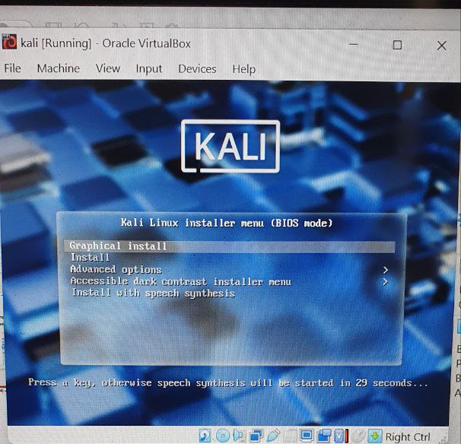
Preparation for Lab 2 (Week 4) – VirtualBox and Kali Linux
Proceed the steps, you will see this

Slide 52
Preparation for Lab 2 (Week 4) – VirtualBox and Kali Linux
Complete Lab Tasks
Take a screenshot of your Kali Linux desktop after a successful installation.
List all problems you encountered during this lab and provide recommendations to fix them.

Slide 53
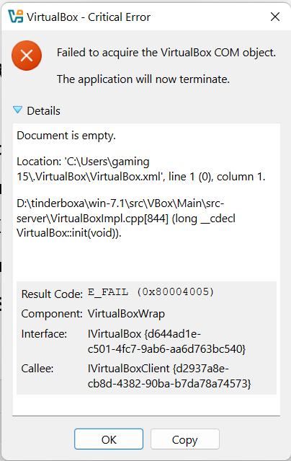
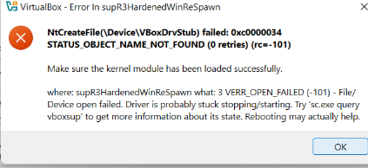
Preparation for Lab 2 (Week 4) – VirtualBox and Kali Linux
In case, if you saw an error like these:
Solution 1: Restart Your Computer
First, restart your computer and try starting Kali Linux again.
If the issue continues, move to Solution 2.

Slide 54
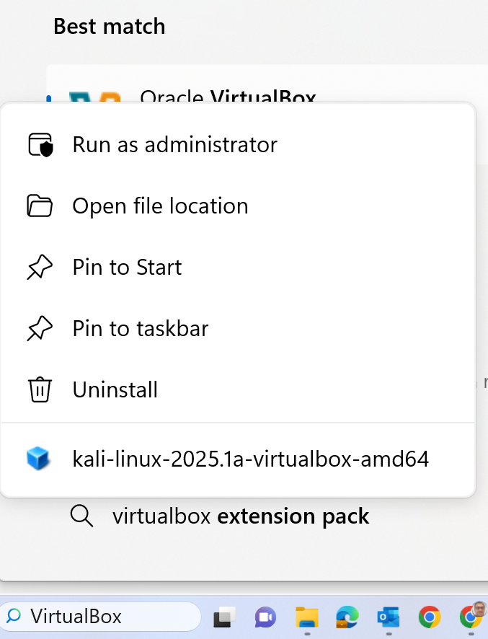
Preparation for Lab 2 (Week 4) – VirtualBox and Kali Linux
Solution 2: Run VirtualBox as Administrator
Close VirtualBox completely.
Right-click on the VirtualBox icon and select "Run as administrator".
Try starting Kali Linux again.

Slide 55
Preparation for Lab 2 (Week 4) – VirtualBox and Kali Linux
Solution 3: Reinstall VritualBox Drivers and VirtualBox Program

Slide 56
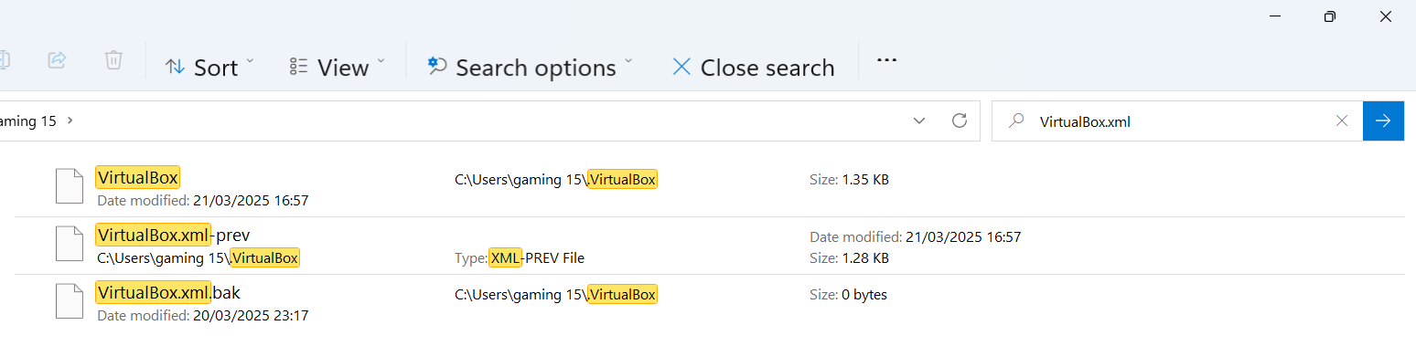
Preparation for Lab 2 (Week 4) – VirtualBox and Kali Linux
Solution 4:
Find the VirtualBox.xml file in your File Explorer: C:\Users\...
If the file is empty or corrupt, rename it to VirtualBox.xml.bak.
Restart VirtualBox to let it generate a new configuration file.

Slide 57
Preparation for Lab 2 (Week 4) – VirtualBox and Kali Linux
Things to Remember:
Follow the steps carefully.
If you face errors, double-check your settings and ensure you downloaded the correct files.
Take notes on issues and how you fixed them – this will help in troubleshooting future problems.
Final Tip: Always back up important data before making significant changes to your system!

Slide 58
Summary of Lab 2 (Week 4)
Preparation for Lab 2 (Week 4) – VirtualBox and Kali Linux
Step 1: Install VirtualBox
Download Oracle VirtualBox.
Install it on your Windows computer.
Step 2: Download Kali Linux
We need the right version for VirtualBox.
There are two ways to do this:
Easier Method (Recommended): Download the Kali Linux VirtualBox Image (.iso file).
Harder Method: Download the Kali Linux ISO file and install it manually.

Slide 59
Summary of Lab 2 (Week 4)
Preparation for Lab 2 (Week 4) – VirtualBox and Kali Linux
Step 3: Import Kali Linux into VirtualBox
If you downloaded the .ova file, just import it into VirtualBox.
If you downloaded the .iso file, you will install Kali Linux manually in VirtualBox.
Step 4: Start and Use Kali Linux
Once installed, start Kali Linux inside VirtualBox.
Use Kali Linux to complete the lab tasks.

Slide 60
Summary of Lab 2 (Week 4)
Preparation for Lab 2 (Week 4) – VirtualBox and Kali Linux
Step 5: Complete Lab Questions
Take a screenshot of Kali Linux running inside VirtualBox.
List any problems you faced and how you solved them.

Slide 61
Summary of Lab 2 (Week 4)
Preparation for Lab 2 (Week 4) – VirtualBox and Kali Linux
This lab helps us:
Understand virtualization and how to run different operating systems.
Learn how to install and configure VirtualBox and Kali Linux.
Prepare for cybersecurity tasks in a safe virtual environment.
Use Kali Linux tools without affecting our main Windows system.

Slide 62
Summary of Lab 2 (Week 4)
Preparation for Lab 2 (Week 4) – VirtualBox and Kali Linux
Final Thought
Think of Oracle VirtualBox as a TV and Kali Linux as a video game console.
VirtualBox (TV) is the platform that runs different operating systems.
Kali Linux (Game Console) is the system we use inside VirtualBox to practice cybersecurity

Slide 63
Submission of Labs & Assessments
These guidelines are designed to support your learning and help you apply necessary techniques effectively. For lab or assessment submissions, please follow instructions and complete tasks based on Canvas. If you have any questions, feel free to ask—I’m happy to help!

Slide 64
Thank You
Have a Great Learning Day!
Feel free to reach out with any questions!
Dr. Farshid Keivanian

